Slide 1

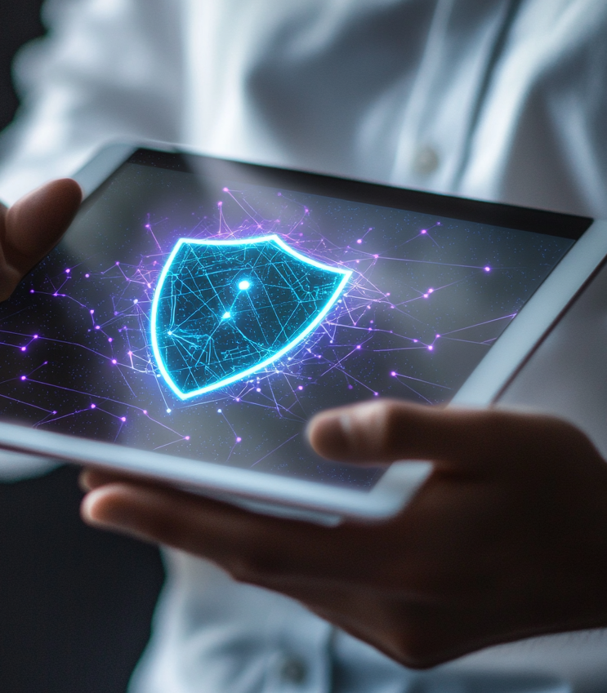
Microsoft Purview
Summary & Conclusion

Slide 2
01
Integrated Strategy and Governance

Slide 3



Governance and Compliance Solution
01
Microsoft Purview
Microsoft Purview enables organizations to comprehensively govern, protect, and manage sensitive information across their entire digital estate.
02
Microsoft Defender
Microsoft Defender offers advanced threat protection to secure your organization’s sensitive data against sophisticated cyber- attacks.
03
Microsoft Sentinel
Microsoft Sentinel provides intelligent security analytics to detect and respond to threats in real- time, ensuring a proactive defense strategy.

Slide 4
Protecting Sensitive Data
Data Classification
01.
Identify and classify sensitive data to ensure appropriate protection measures are implemented throughout the data lifecycle.
Data Encryption
02.
Utilize encryption technologies to safeguard sensitive data both at rest and in transit, ensuring data confidentiality and compliance.
Access Controls
03.
Implement robust access controls to limit data access to authorized personnel, minimizing the risk of data breaches and leaks.

Slide 5
Designing Retention and DLP Strategies
Retention Policies
DLP Policies
Policy Implementation
Create and enforce retention policies to manage data lifecycle, ensuring compliance with regulatory requirements and organizational policies.
Deploy Data Loss Prevention (DLP) policies to detect and prevent data leaks by monitoring and controlling data transfers.
Ensure the successful implementation of retention and DLP policies through continuous monitoring, assessment, and adjustment as needed.
01
02
03

Slide 6
02
eDiscovery for Incident Response

Slide 7
Configuring eDiscovery
eDiscovery Tools
Search and Collection
Data Preservation
Utilize eDiscovery tools to identify, collect, and preserve electronically stored information (ESI) for legal and investigative purposes.
Perform comprehensive searches to collect relevant ESI, ensuring it is readily accessible for analysis and review.
Implement measures to preserve data integrity and prevent spoliation, maintaining the evidentiary value of collected data.

Slide 8



Incident Management
01
02
03
Incident Identification
Response Protocols
Forensic Analysis
Develop strategies for the early identification of security incidents, enabling a prompt and effective response.
Establish incident response protocols to manage and mitigate the impact of security incidents, reducing potential damage.
Conduct forensic analysis to understand the root cause of incidents, aiding in the prevention of future occurrences.

Slide 9
Legal and Regulatory Compliance
01
02
03
Regulatory Requirements
Legal Hold
Compliance Audits
Stay informed of relevant regulatory requirements to ensure compliance and avoid legal penalties.
Implement legal hold processes to prevent the alteration or destruction of potentially relevant ESI during legal proceedings.
Conduct regular compliance audits to verify adherence to legal and regulatory standards, identifying areas for improvement.

Slide 10
03
Building an Auditing Plan

Slide 11
Security Audits
01
Audit Framework
Develop a comprehensive audit framework to systematically evaluate the security posture and compliance of the organization.
02
Audit Tools
Leverage advanced auditing tools to automate the auditing process, increasing efficiency and accuracy.
03
Audit Reporting
Generate detailed audit reports to document findings, recommendations, and corrective actions required to enhance security and compliance.

Slide 12


Compliance Audits
Internal Audits
External Audits
Conduct internal audits to assess adherence to internal policies and procedures, identifying areas for improvement.
Engage external auditors to perform independent assessments, providing an unbiased evaluation of the organization's compliance status.
Continuous Monitoring
Implement continuous monitoring practices to ensure ongoing compliance and timely identification of non- compliance issues.

Slide 13
Risk Management
Risk Assessment
Risk Mitigation
Perform regular risk assessments to identify potential threats and vulnerabilities, allowing for proactive risk management.
Develop and implement risk mitigation strategies to reduce the impact and likelihood of identified risks.
Risk Reporting
Communicate risk findings and mitigation efforts to stakeholders through comprehensive risk reports, ensuring transparency and informed decision- making.

Slide 14
Thanks

